Slide 1
Evolution
Evolution of DNA sequences

Slide 2
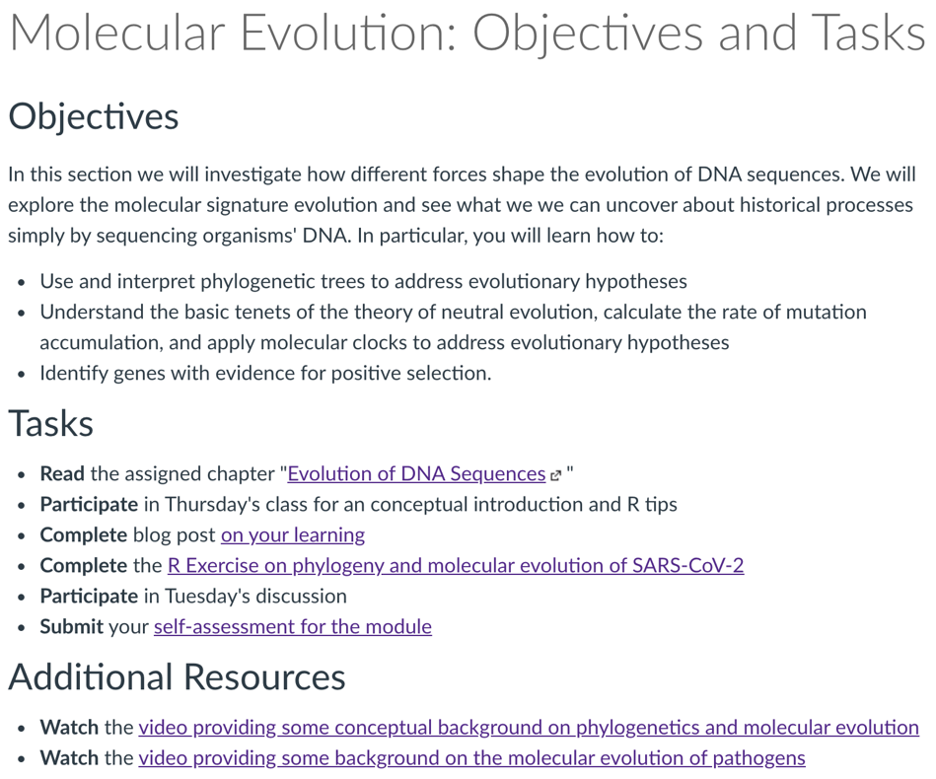
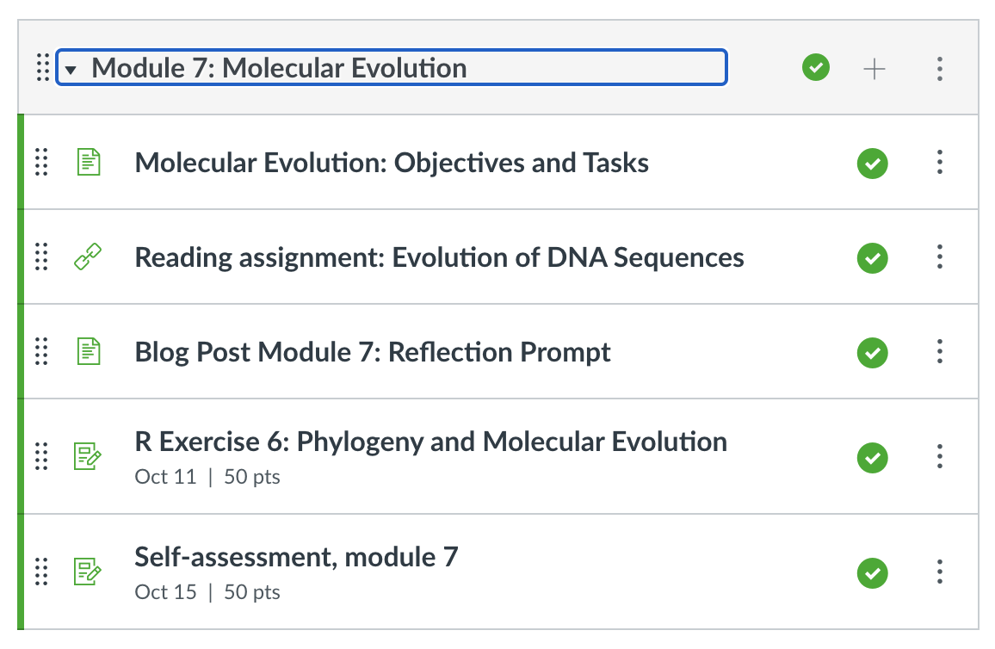

Slide 3
DNA holds clues about genealogy and modes of evolution
DNA sequencing
Sequence alignment

Slide 4
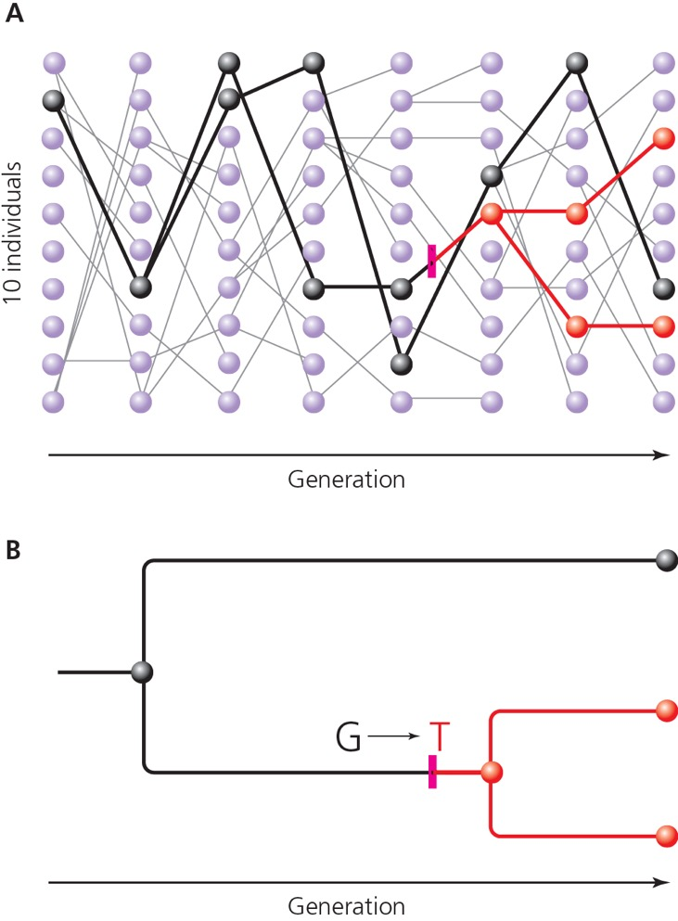
Molecular phylogenetics: coalescence
We can trace genealogies of genes back through time, reconstructing when mutations generated new alleles
Coalescence is the process by which genealogies of a pair of alleles merges in a common ancestor

Slide 5
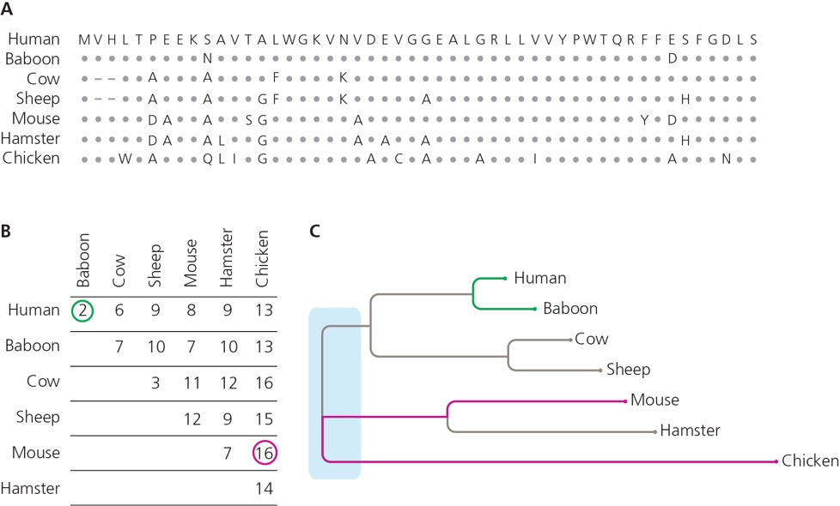
Molecular phylogenetics: methods
Simple approaches quantify the number of differences in the DNA sequence between species
Other approaches model patterns of molecular evolution
Phylogenetics is computationally intensive; there are over 34,000,000 possible trees for 10 taxa

Slide 6
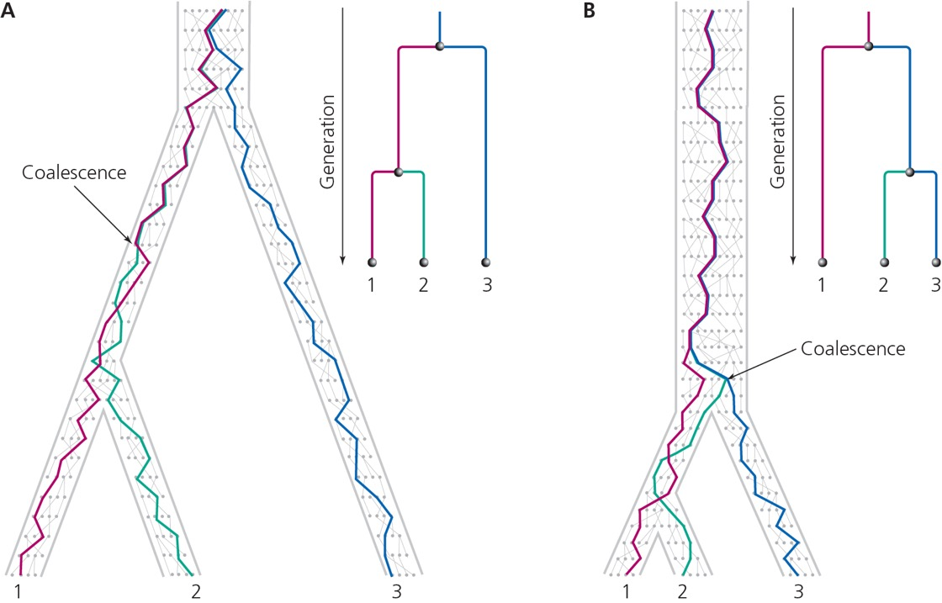
Molecular phylogenetics: gene vs. species trees
Gene trees are branched genealogies of homologous alleles
Patterns of coalescence of individuals may or may not be consistent with the the species tree (actual genealogy)
Sequencing many genes is required

Slide 7
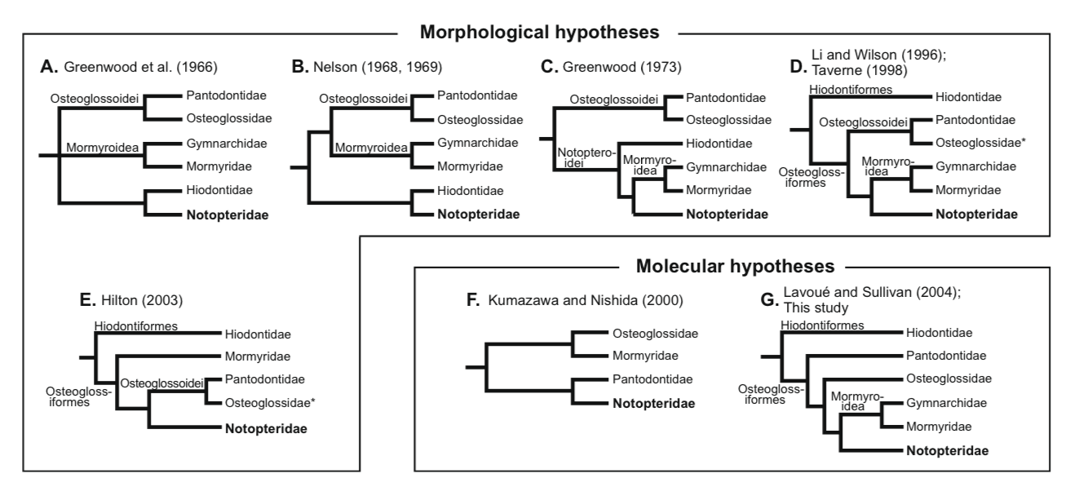
Phylogenies are hypotheses!
Phylogenies are hypotheses because we indirectly infer evolutionary branching patterns rather than directly observing them
Using different sets of data can lead to alternative hypotheses about evolutionary relationships

Slide 8
Decoding the history of life
At broad scales…

Slide 9
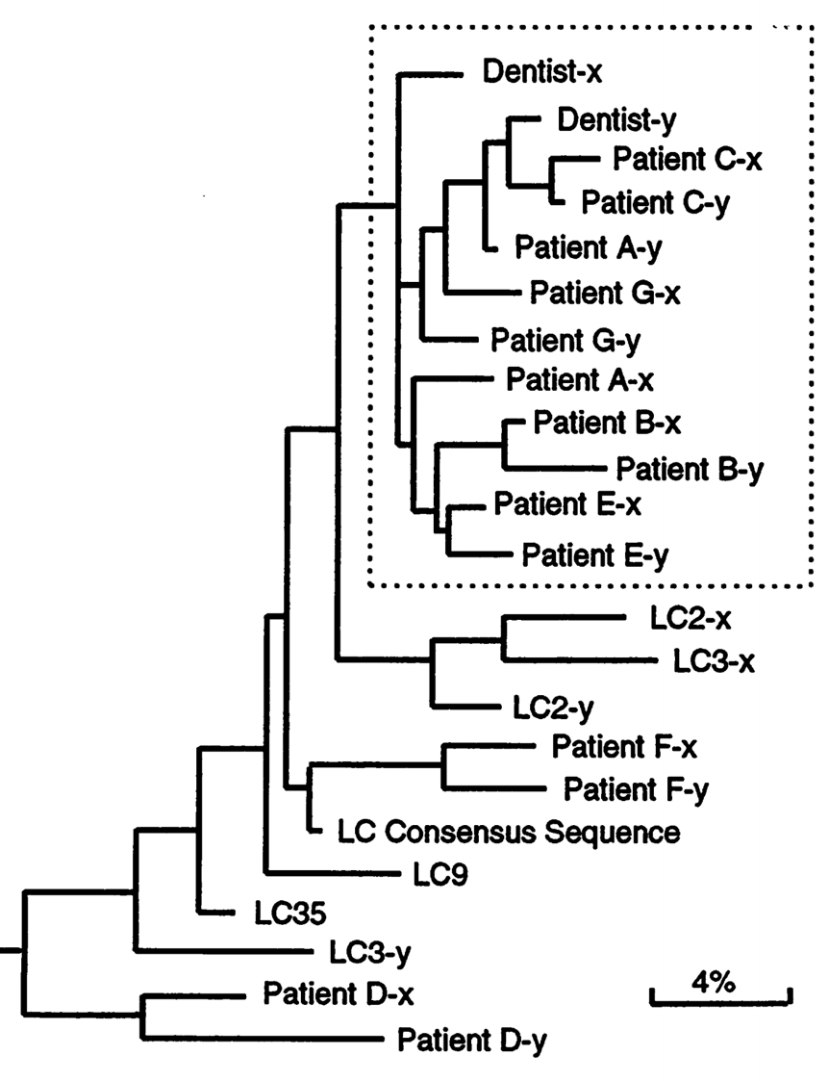
Decoding the history of life
And at narrow scales…

Slide 10
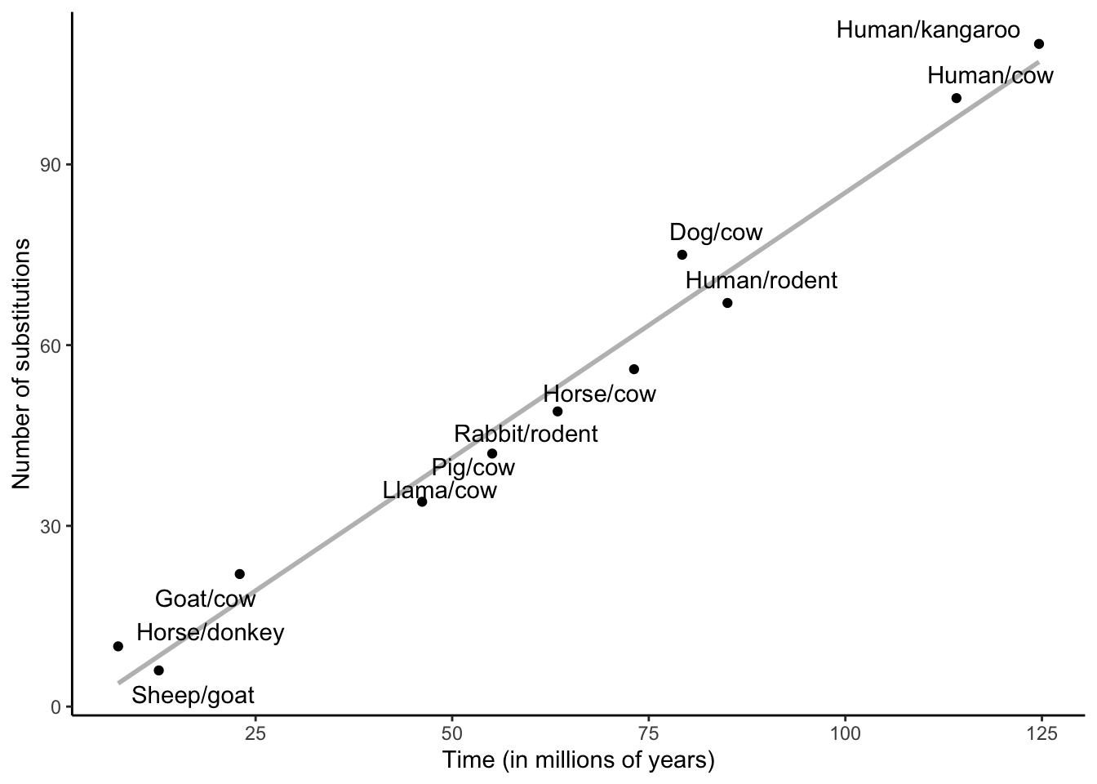
Selection vs. neutral evolution
Much variation in DNA is hardly affected by selection at all
Mutations escape selection if they do not affect the phenotype
Neutral mutations become fixed in populations at a roughly regular rate (1/2N) due to genetic drift

Slide 11
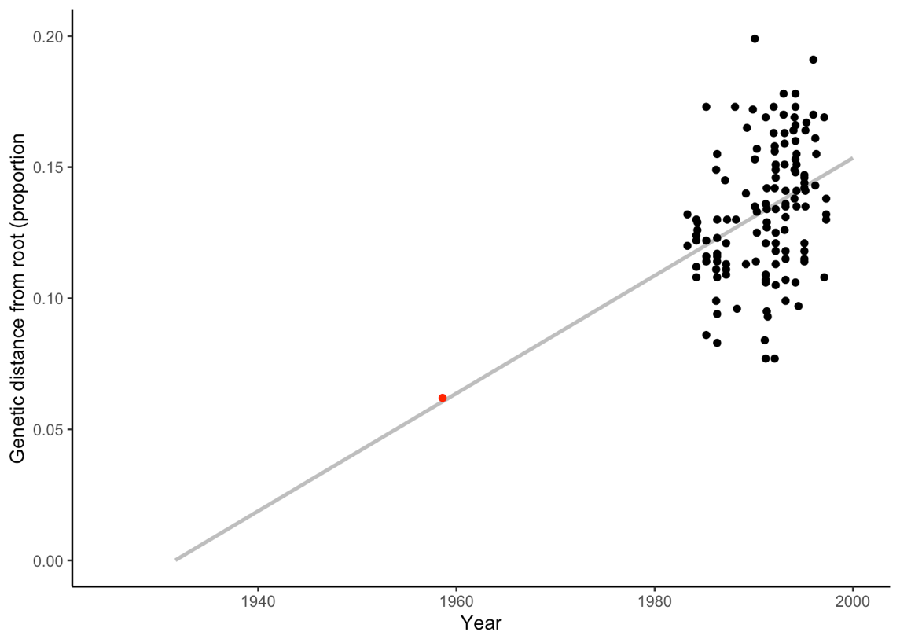
Molecular clocks
Molecular clocks use the rates of molecular change to deduce the divergence time between two lineages
When there is no time series, this requires assumptions about the rate of evolution

Slide 12
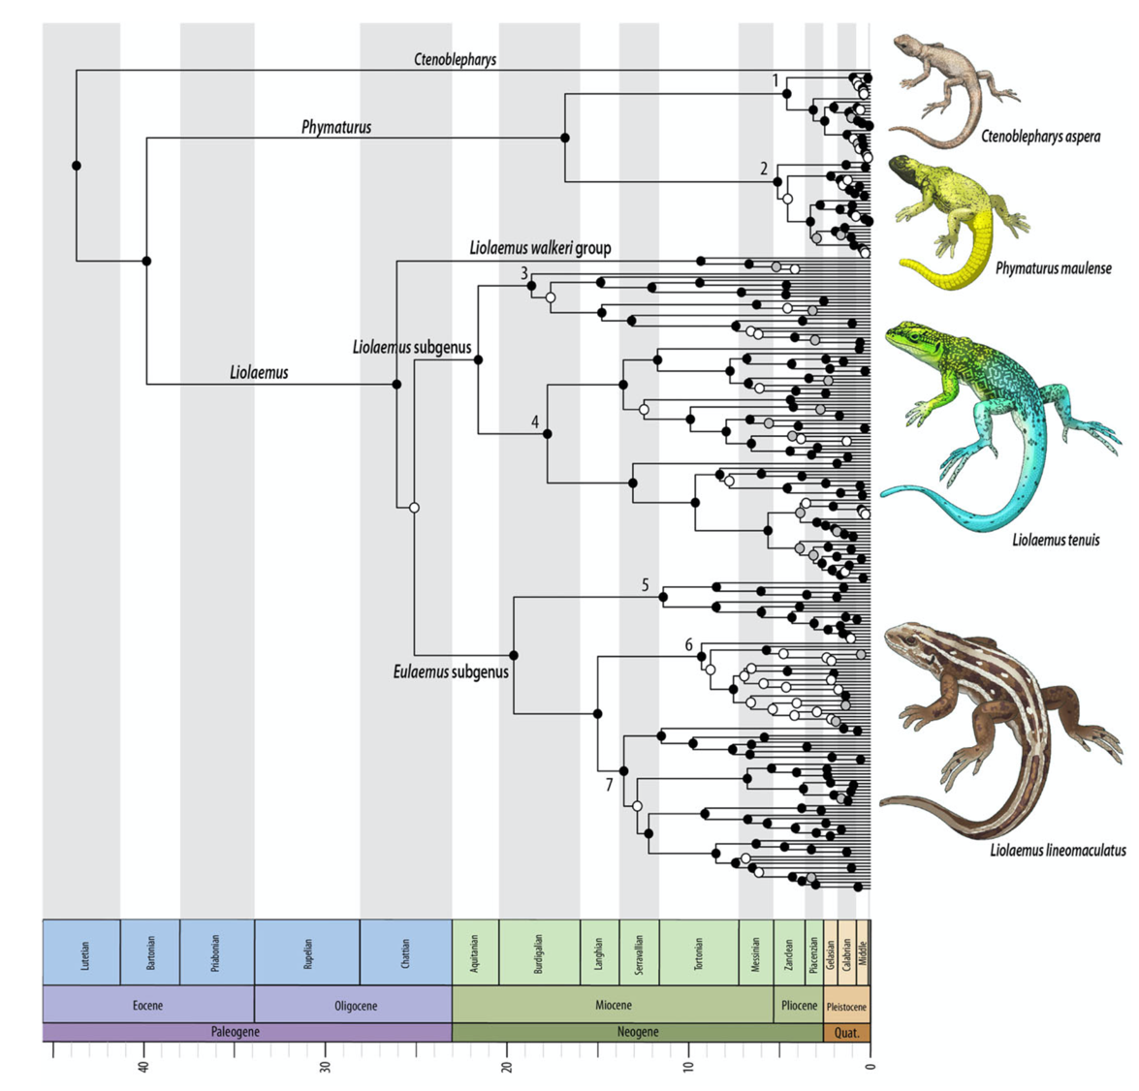
Molecular clocks
Molecular clocks use the rates of molecular change to deduce the divergence time between two lineages
When there is no time series, this requires assumptions about the rate of evolution
Can be calibrated with fossils

Slide 13
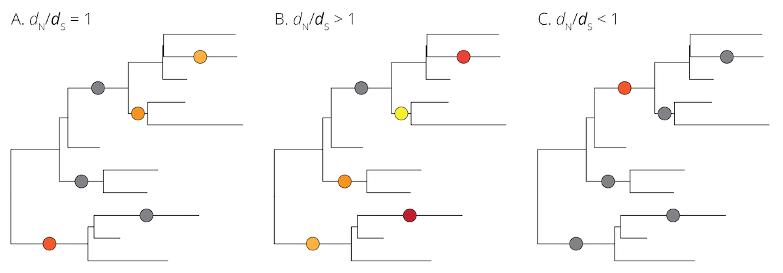
Footprints of selection
If neutral alleles become fixed at a regular rate, deviations from that rate can be indicative of selection
For neutral drift, d_{N} is about the same as d_{S}
Positive selection: a gene acquires replacement substitutions that raise fitness (d_{N} > d_{S})
Negative selection: replacement substitutions in a gene lower the fitness and are lost (d_{N} < d_{S})

Slide 14
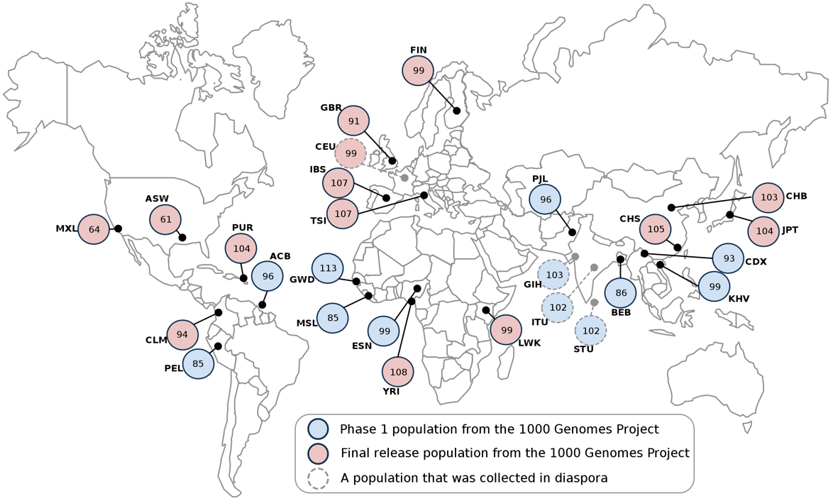
The power of DNA sequencing
Deviations from neutral assumptions in genes associated with diet, climate, and infectious disease
Positive selection on lactose genes associated with domestication of cattle and sheep
Positive selection on pigmentation genes in non-African humans (negative selection in African populations)
Positive selection on immune genes

Slide 15
Molecular evolution of pathogens

Slide 16
Pathogen evolution
Pasteur suggested that contagious diseases are caused by pathogens in 1858
Pathogens as evolving populations

Slide 17
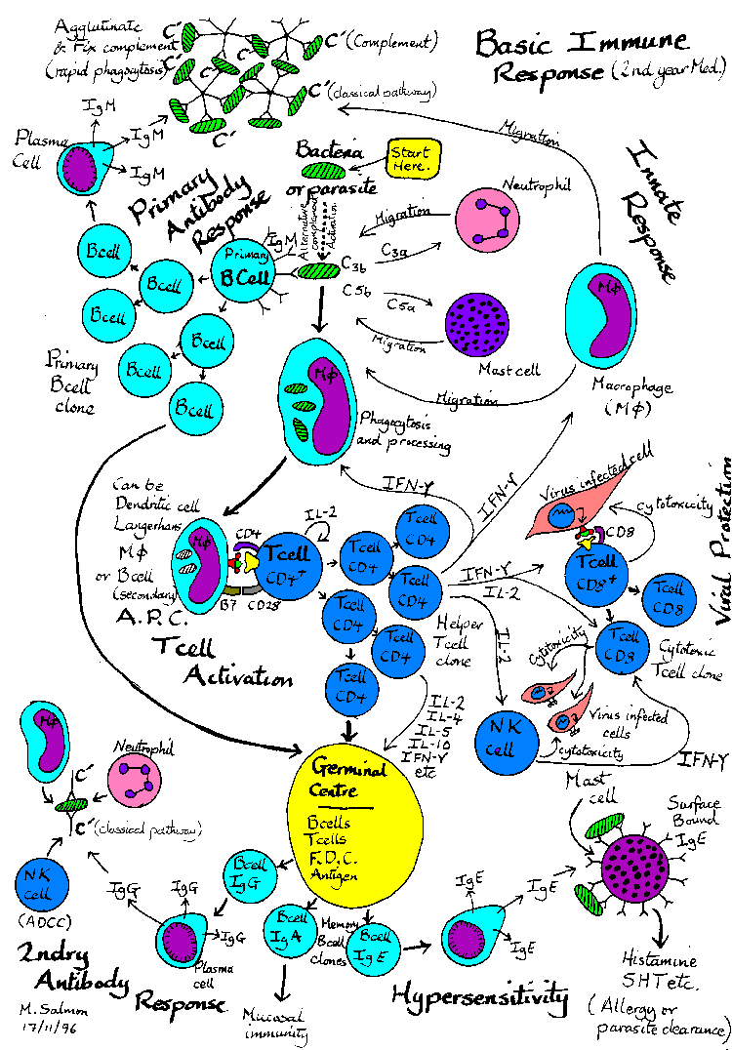
Evading the host immune system
Conflict between host and pathogen
Hosts are selected for minimizing pathogens’ success
Pathogens are selected for evading the hosts’ immune response
Co-evolutionary arms race
Who do you think has the upper hand in this arms race?
Pathogens have high populations sizes, short generation times, and high mutation rates

Slide 18
Host-pathogen interactions: the common flu
Influenza A consists of 8 RNA strands that code for 11 proteins
Hemagglutinin as primary protein involved in initiating infection and primary target site of immune response (at antigenic sites)
To persist in a population, Influenza A strains need to either find naïve hosts or change surface proteins that exposed hosts have not yet encountered

Slide 19
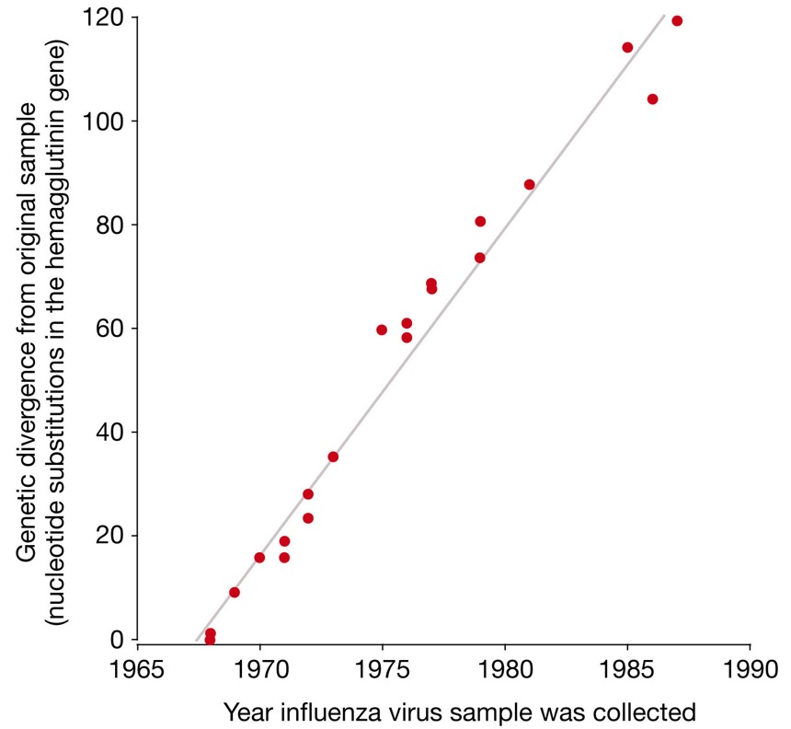
Flu evolution
How did hemagglutinin genes change over time (1968 to 1987, equals about 20 million years of mammalian evolution)?
Steady accumulation of nucleotide substitutions over time

Slide 20
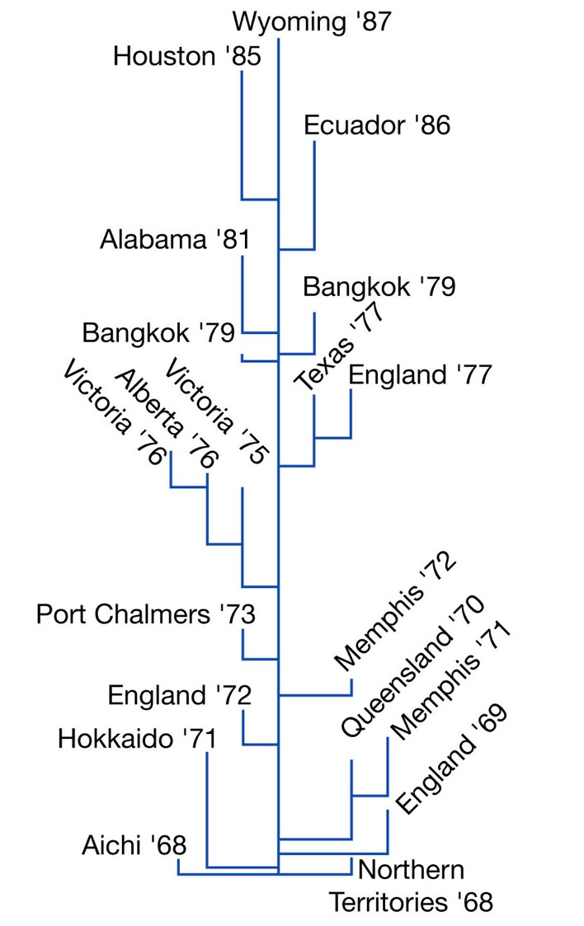
Flu evolution
How did hemagglutinin genes change over time (1968 to 1987, equals about 20 million years of mammalian evolution)?
Steady accumulation of nucleotide substitutions over time
Most strains represent extinct branches on the phylogeny

Slide 21
Flu evolution
What allowed the surviving strains to endure while others went extinct?
Surviving lineages had disproportionate number of mutations in antigenic sites
Positive selection on 18 codons within antigenic sites
Immune response drives pathogen evolution!

Slide 22
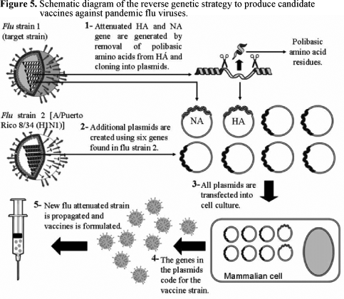
Predicting flu evolution
Vaccine development is time consuming and must start well before flu season
How would you apply what you just learned about flu evolution to advice vaccine development?

Slide 23
Predicting flu evolution
Vaccine development is time consuming and must start well before flu season
How would you apply what you just learned about flu evolution to advice vaccine development?
Strains with the most non-synonymous mutations in hemagglutinin antigenic sites should have highest fitness
More than 9 of 11 flu seasons are accurately predicted!

Slide 24
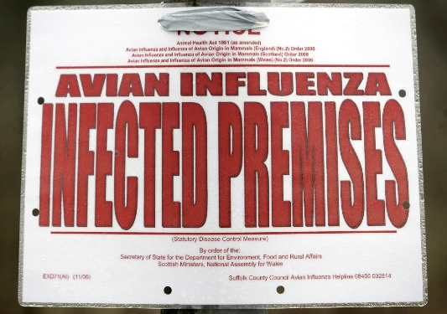
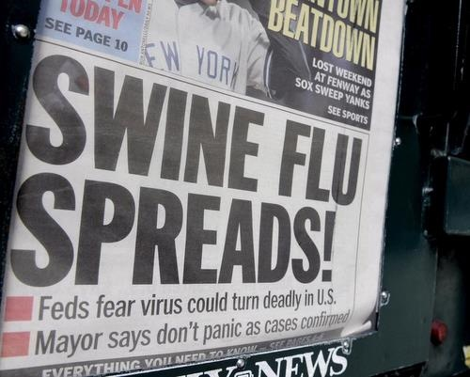
Pandemic flu strains
Pandemic strains infect a lot of people and induce high mortality, because of radically different antigenic sites
Where do radically different antigenic sites come from?

Slide 25
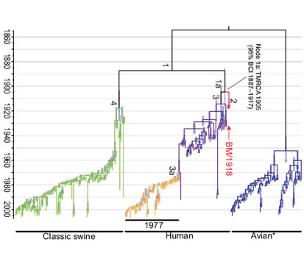
Pandemic flu strains
Distinct clades of flu viruses infect particular organismal groups
Occasionally, cross infections occur (e.g., from swine to human or from bird to human)
If individuals are infected with two strains at the same time (e.g., human strain and swine strain), recombinant strains might evolve
Continuous monitoring of flu strains allows for early detection and vaccine development (e.g., H1N1)

Slide 26
Coronavirus
Common virus infecting humans
Causes upper respiratory tract infections (common cold)

Slide 27
Coronavirus
Common virus infecting humans
Causes upper respiratory tract infections (common cold)
R Notebook
How can we understand SARS-CoV-2, the virus causing COVID-19, from an evolutionary perspective?

